Slide 1

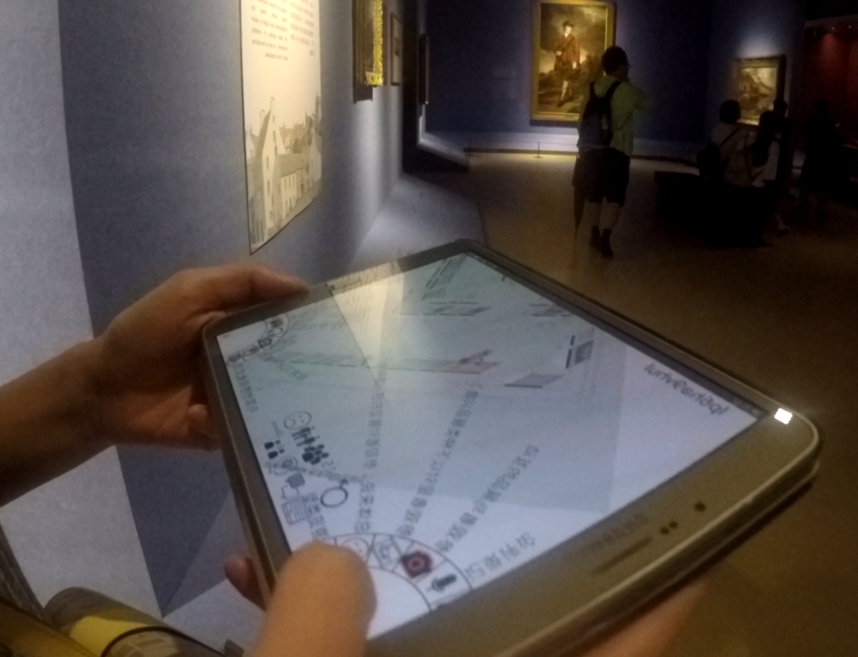
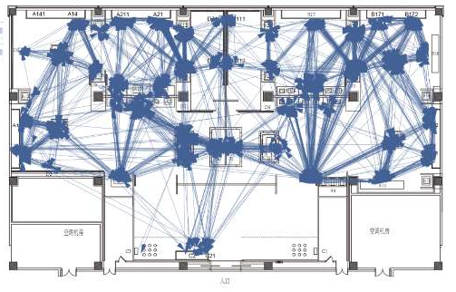
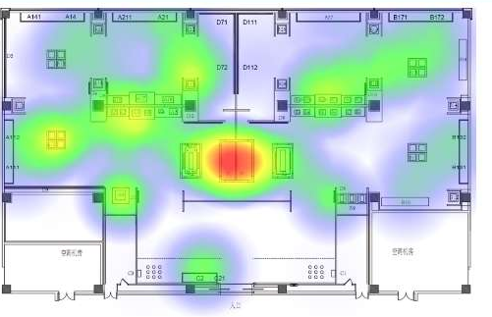
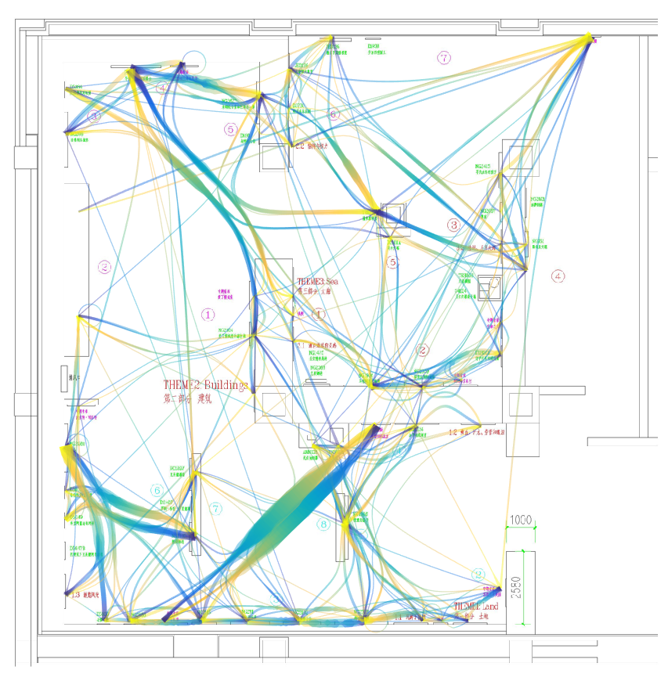
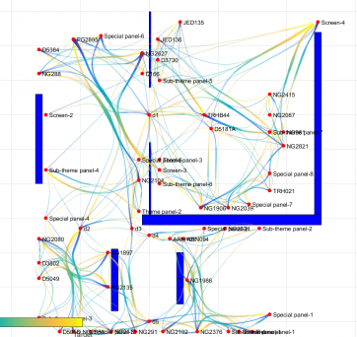
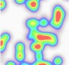
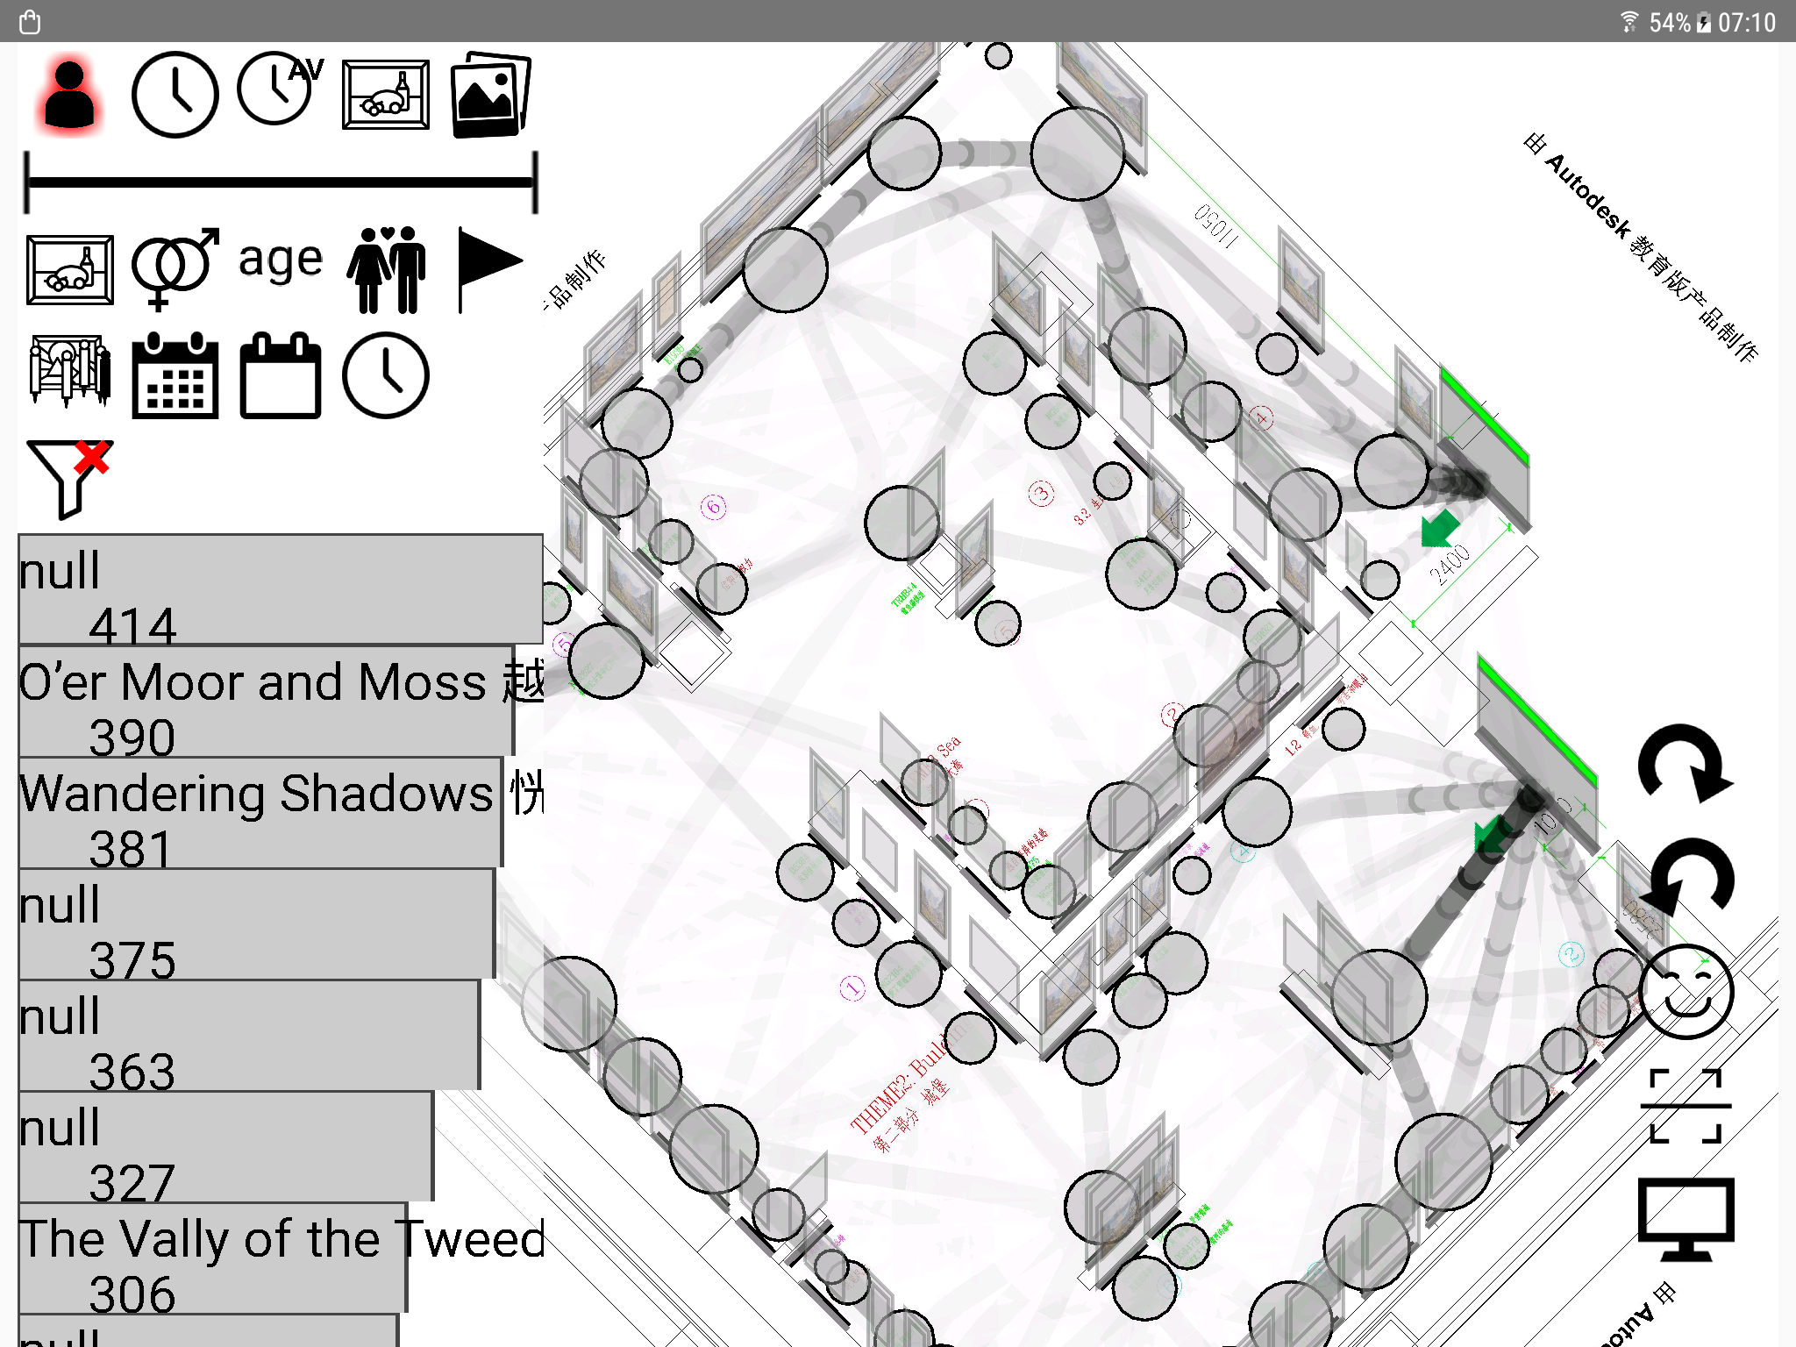
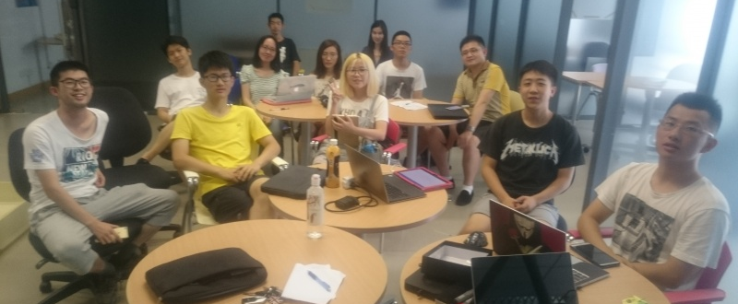
Effective Information Visualization of Museum Visitor Behaviour and Movement Data with Edge Bundling and Curved Lines
SURF201732
Ke Wang, Chao Xiang, Kun Wang, Wenjun Chen, Yuxuan Zhao, Zifan Wang, Yuexuan Li, Zhejian Zhang, Xiaoyu Wu, Weiyi Zhang, Yunao Wu RAs: Zhiqiang Gao, Jiabei Li Supervisors: Paul Craig, Joon Sik Kim, Yiwen Wang
Abstract
This project investigates the use of edge bundling and curved lines to visualize the path of visitors around a museum exhibition. Edge bundling was found to reduce clutter for an effective overview of the data. Quadratic curved lines can be used with transparency and an animated flow effect to give a similarly effective overview of the data and can be integrated into an interactive interface.
Background
Point to point tracking using specialized tracking technology allows us to record the movement and behavior of visitors to a museum exhibition. Traditionally this data is visualised using a directed graph using straight lines and suffer from the problem of crossing lines and clutter when larger amounts of visitor data are included
Edge Bundling
Edge bundling gathers similar paths together and can reduce clutter for an effective overview of the data. The algorithm is however computationally expensive and cannot be applied repeatedly without causing the interface to become unresponsive.
Curved Lines
Quadratic curved lines can be used with transparency and an animated flow effect to give a similarly effective overview of the data without the interface becoming unresponsive. Curved lines are also easier interpret when the data is filtered in an interactive interface.
Prototype interface
Our prototype interface runs on Android devices allowing the data to be interactively filtered according to different criteria. The interface can run on an android tablet or a mobile phone linked to a large display.
Conclusion and future work
We investigated the usefulness of edge-bundling and curved lines for the visualization of point-to-point visitor tracking data. This allowed us to develop a novel technique for visualizing visitor tracking data using quadratic curves, transparency and animation and implemented this technique in an interactive interface. The technique will be further evaluated at Nanjing Museum before being adapted for other museum exhibitions and similar indoor environments such as super-markets and shopping malls.

